Slide 1
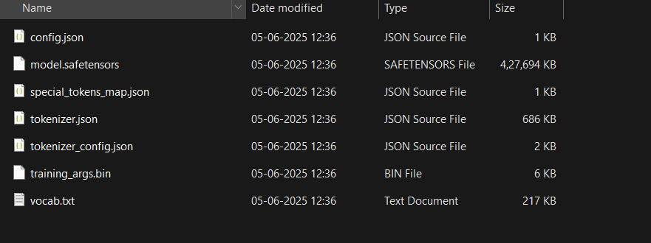
This is the screen shot of original weights folder unfortunenately they are above 100mb so cant be pushed on github

